Slide 1

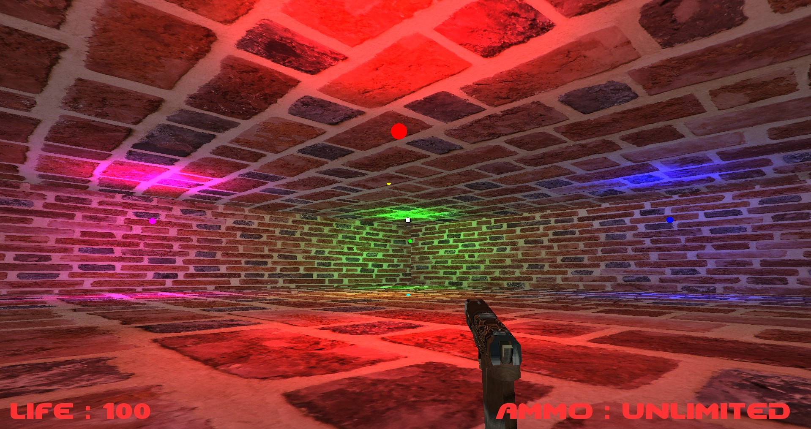
CONDAMNATION

Slide 2
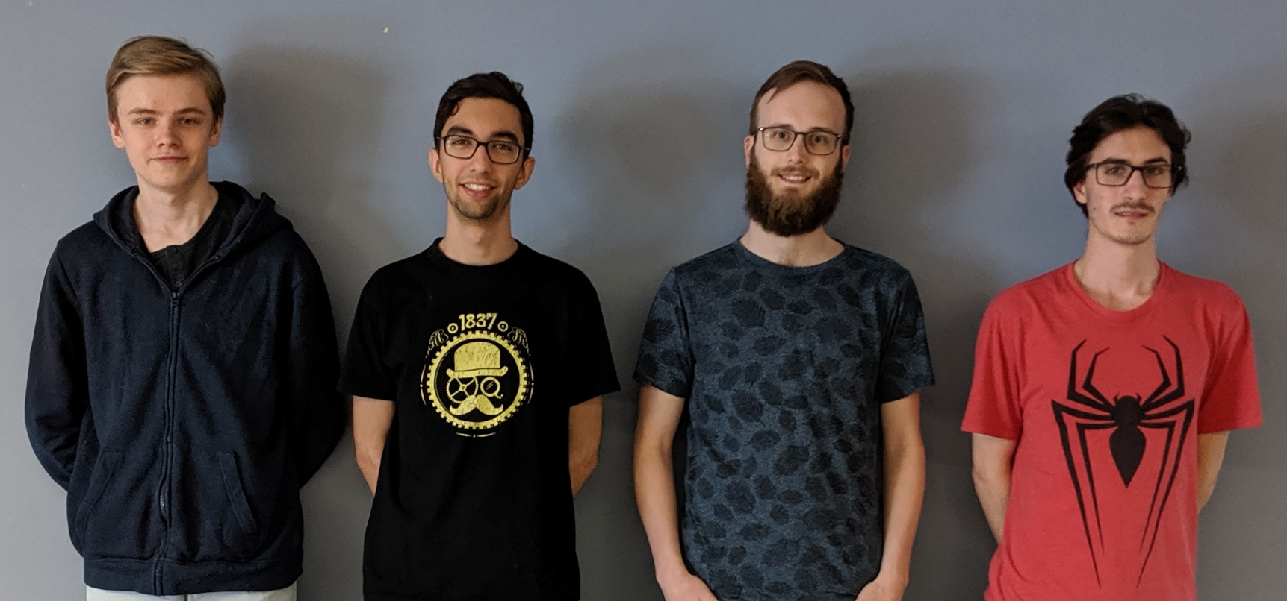
The team
Victor
Filipe
Gabriel
Lilian

Slide 3
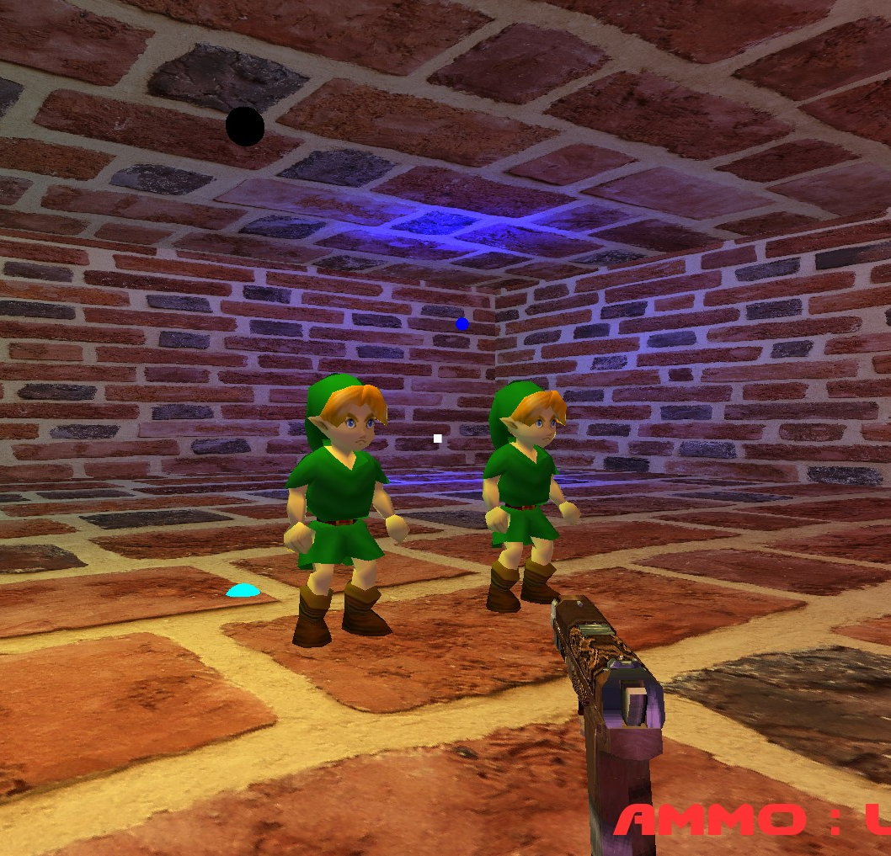
Summary
Rendering Engine
Physics Engine
Component System
Architecture

Slide 4
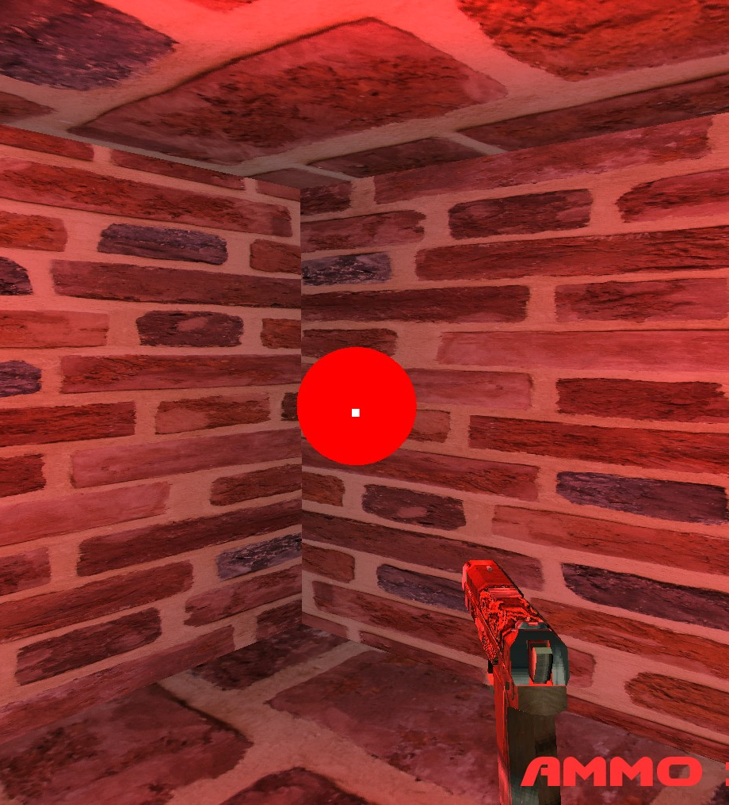
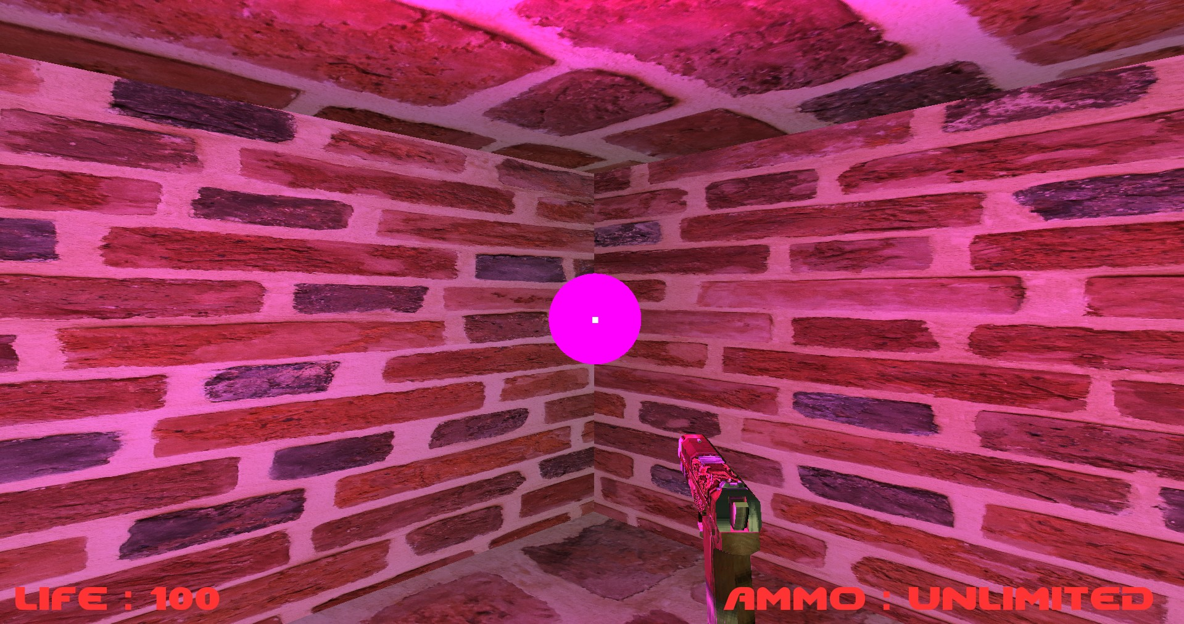
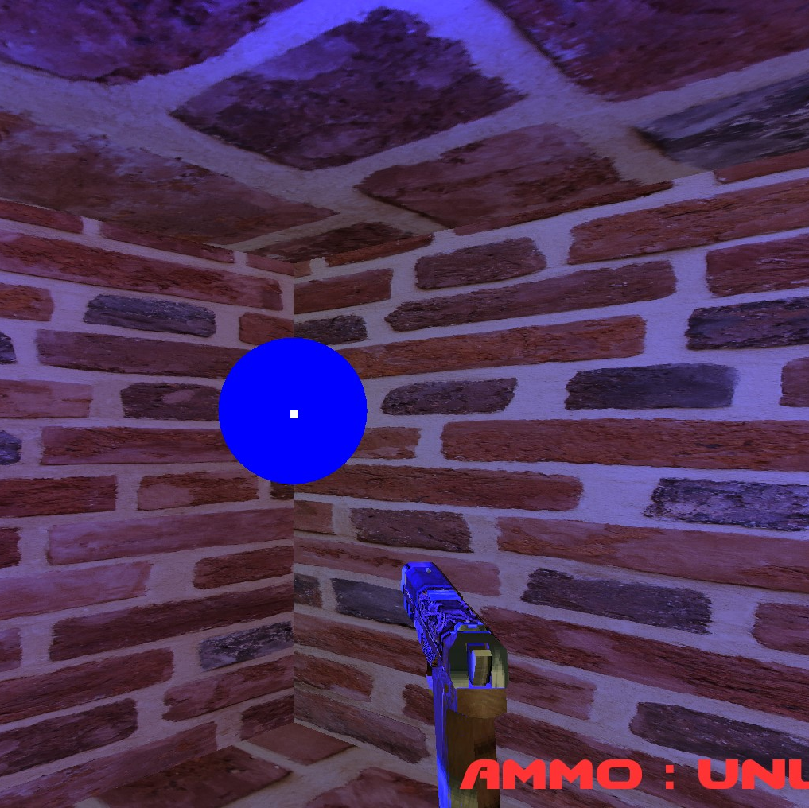
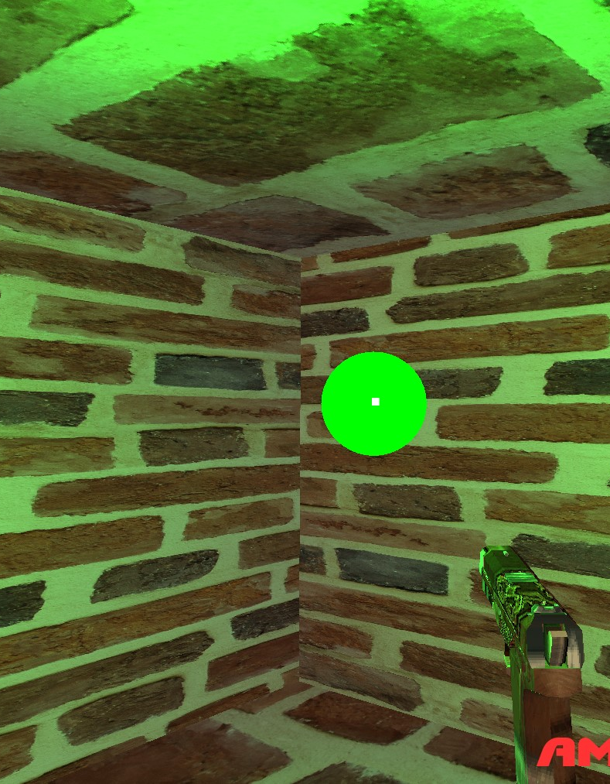
Rendering Engine

Slide 5
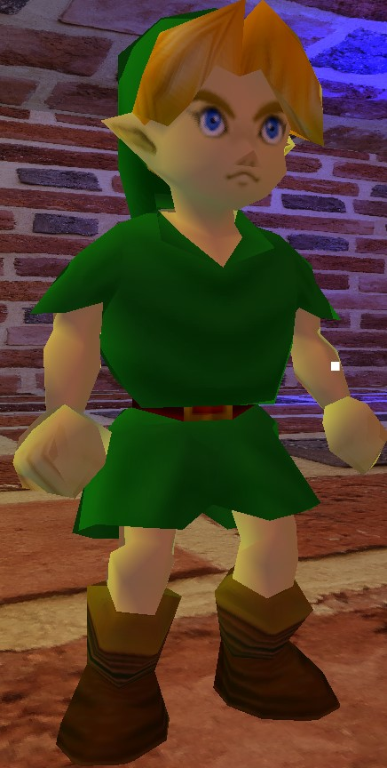
Rendering Engine
Phong lighting
Texturing
UI with FreeType

Slide 6
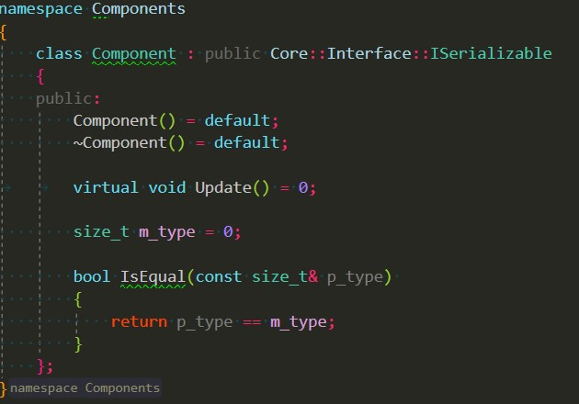
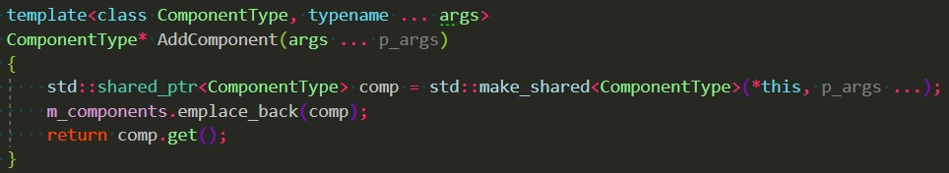
Component system
Unity-inspired
Abstract Component class
Reference to GameObject

Slide 7
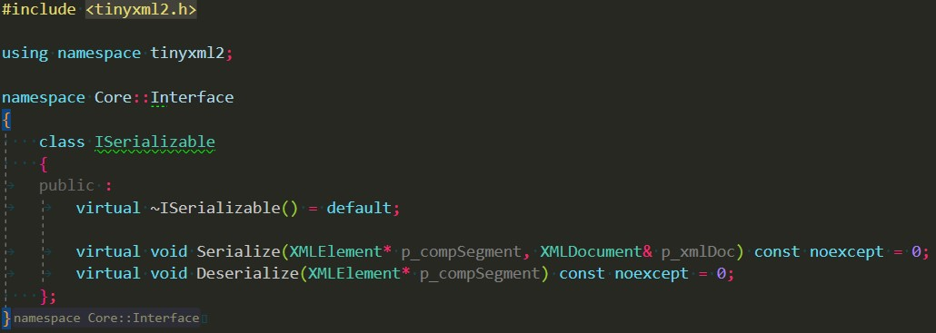
Architecture
Serialization
GameObjectManager contains GameObjects
Singleton input manager
Flyweight system for meshloader, shaderloader

Slide 8
Physics Engine
Rigidbody
Gravity
AddForce
BoxColliders : AABB system
RayCast

Slide 9
Questions?

Slide 10
Thank you

